Slide 1

Game Developer’s Conference

Slide 2
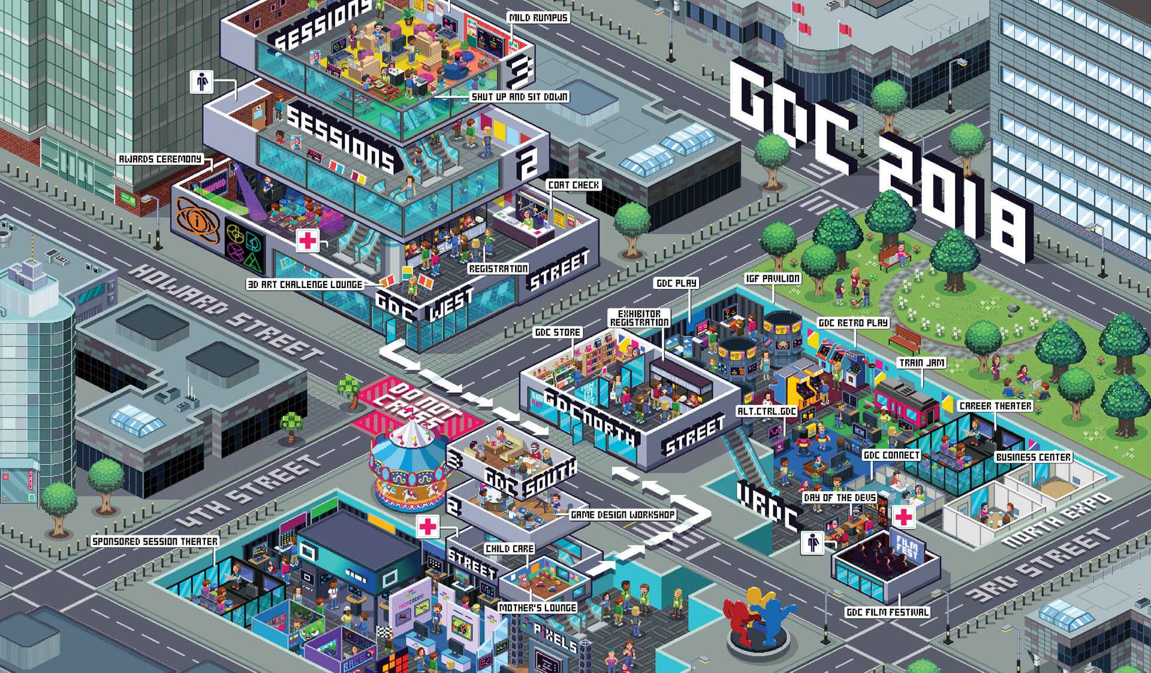
What is GDC?
The Game Developer Conference (GDC) is an annual gathering in San Diego:
Notes:
Artists
Designers
Engineers
Educators
Producers
Industry Big-Wigs
Others involved in games

Slide 3
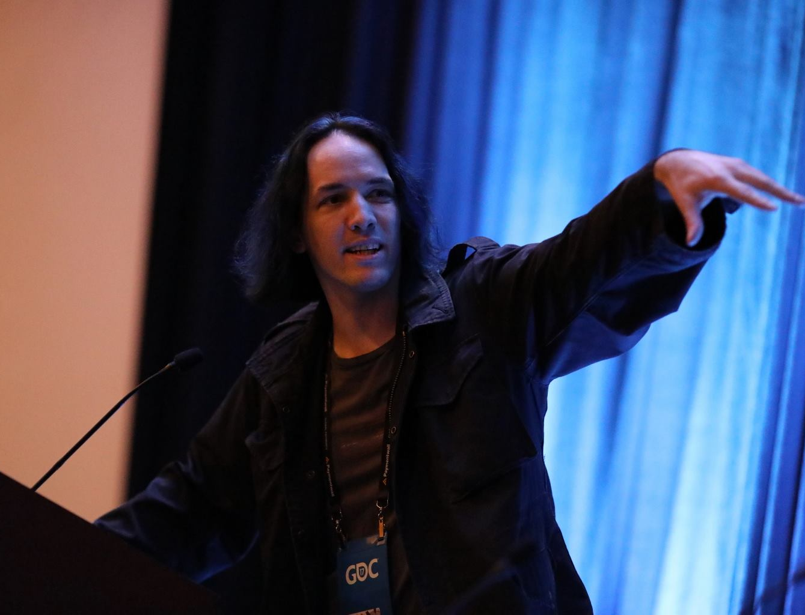
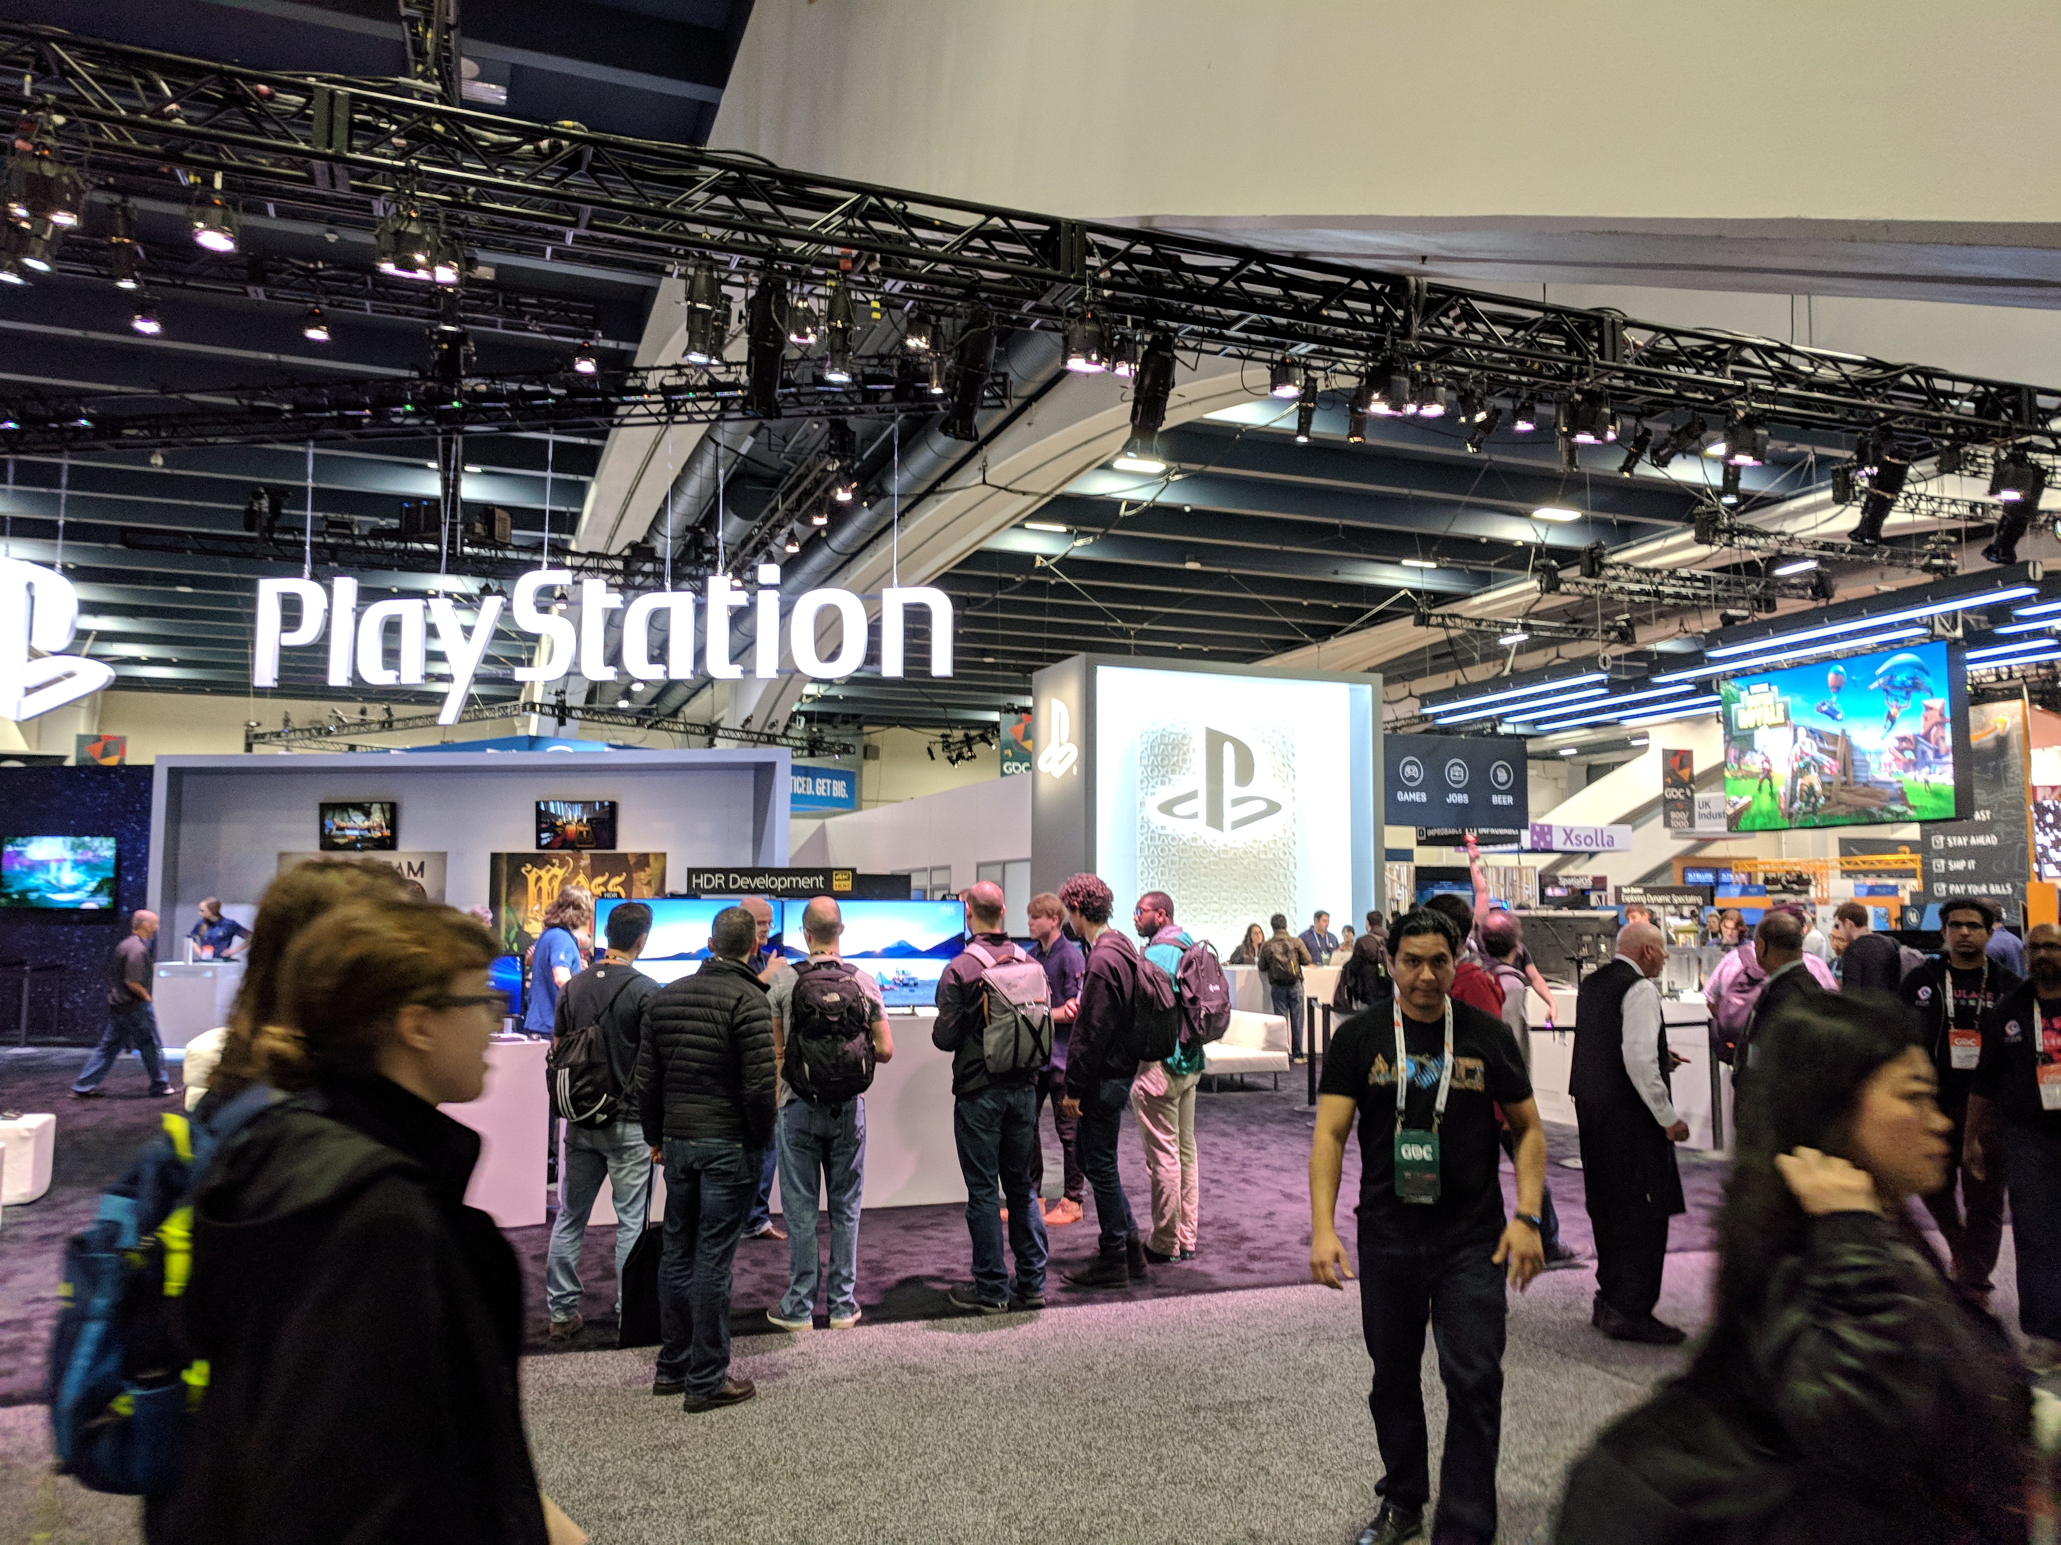
What Happens At GDC?
GDC’s main purpose is to bring professionals together – it’s not E3!
GDC is how game developers stay connected to their professional community.
Notes:
Share latest hardware “sneak peaks”
Make big software announcements
Hear /share about new techniques
Find a new job / hire new people
Networking with industry peers
Market to developers / educators

Slide 4
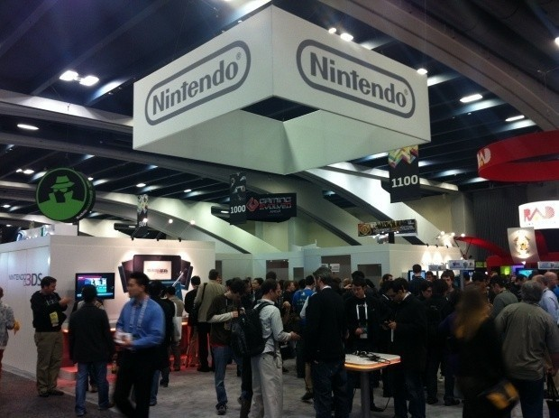
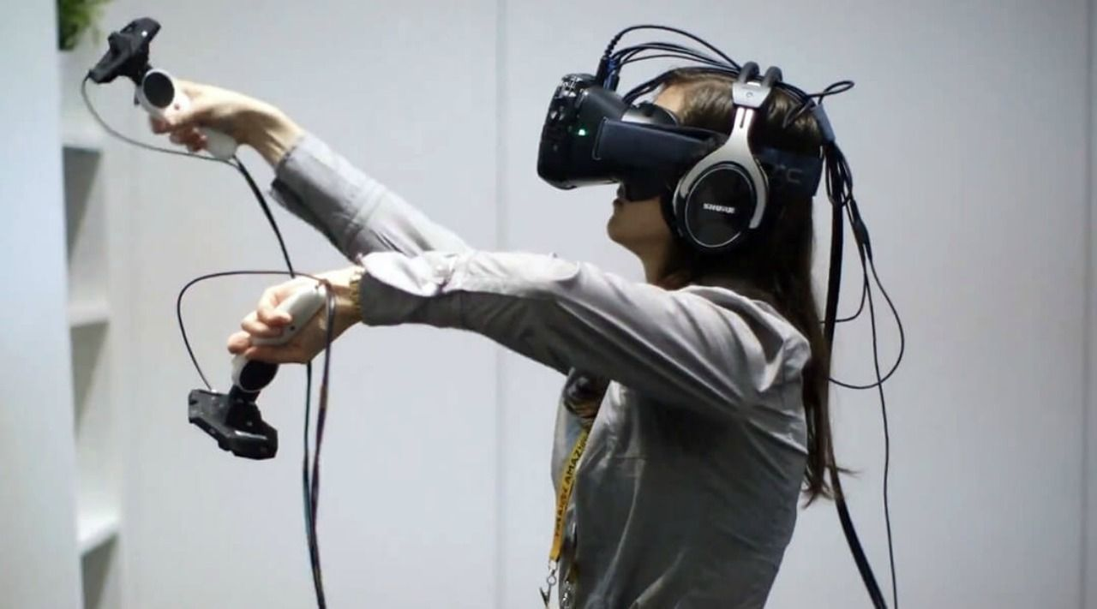
Latest Hardware
It is often where developers first handle new hardware.
Notes:
2008: Emotiv Headset
2010: Nintendo 3DS
2015: HTC Vive
2018: NVIDIA Ray-Tracing

Slide 5
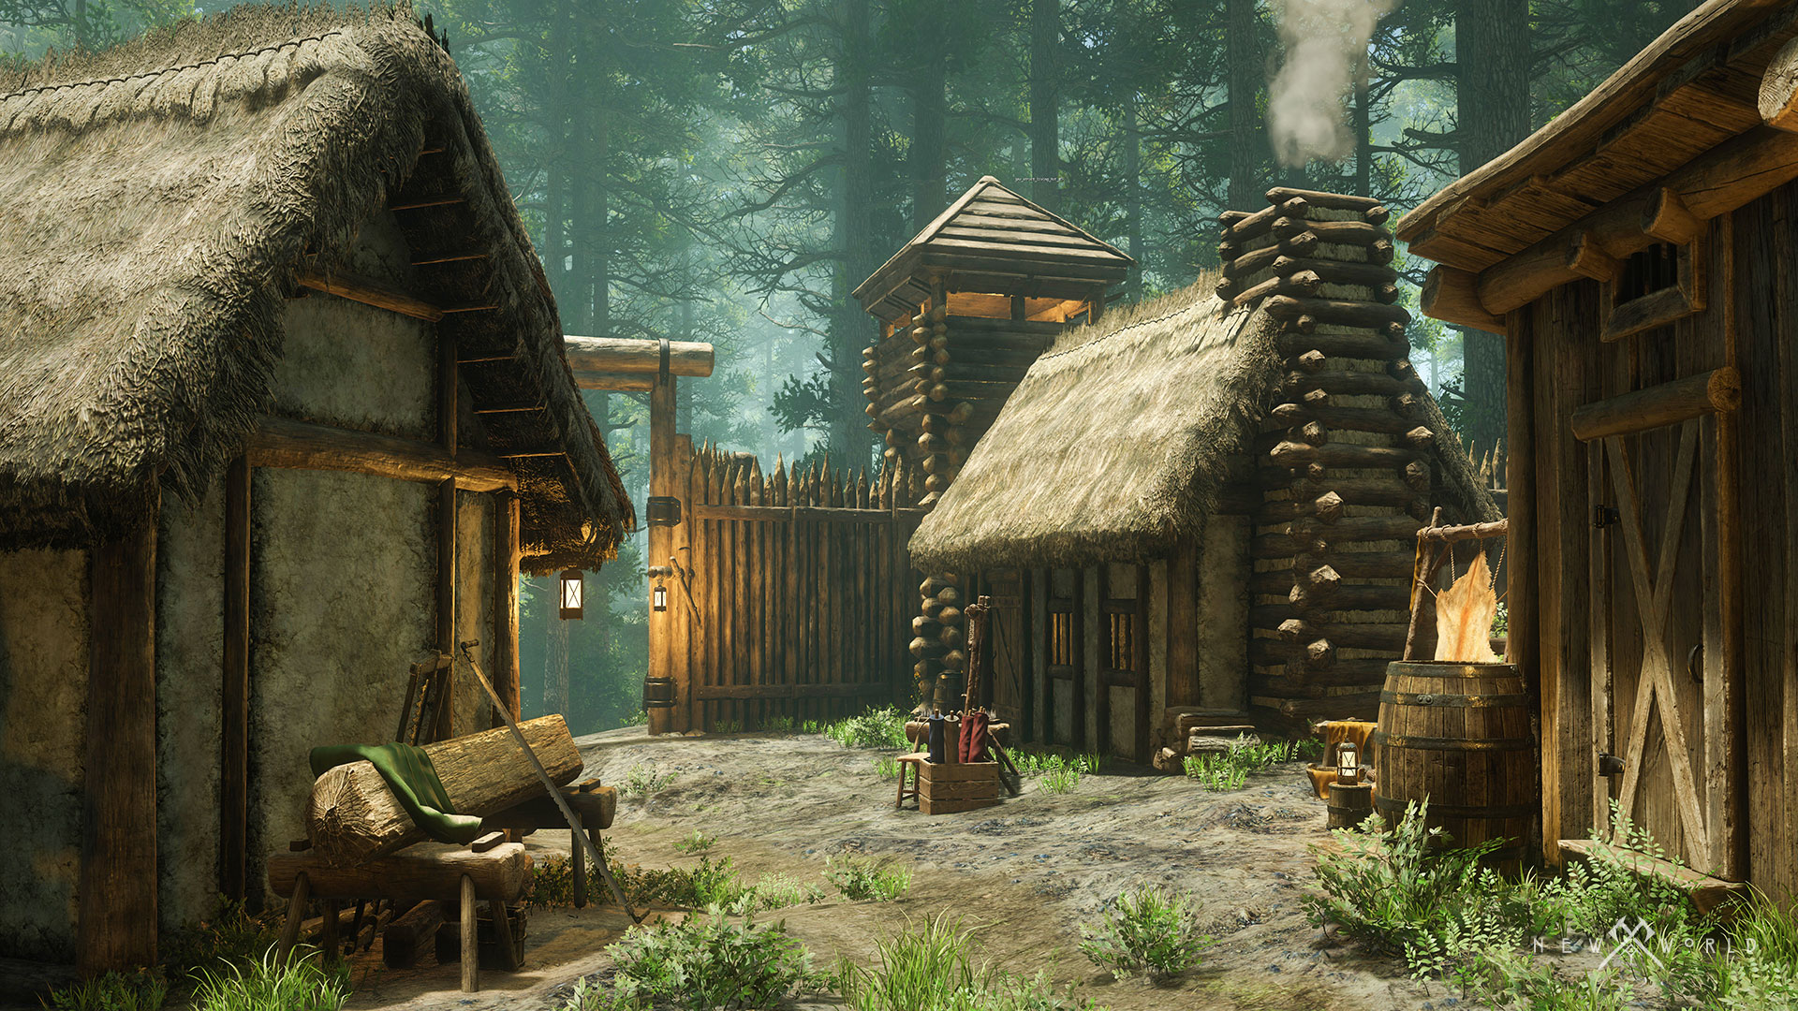
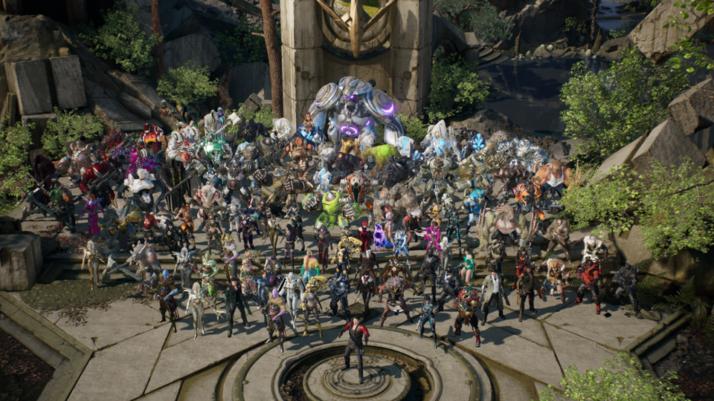
Software Announcements
It’s also a time when new software offerings are publicized (to great effect):
Notes:
2014: Unreal goes to “shared source” model
2015: Valve releases OpenVR SDK (open source)
2016: Amazon Lumberyard Engine (with source)
2018: Epic: millions of dollars in assets for free

Slide 6
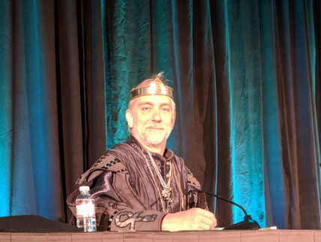
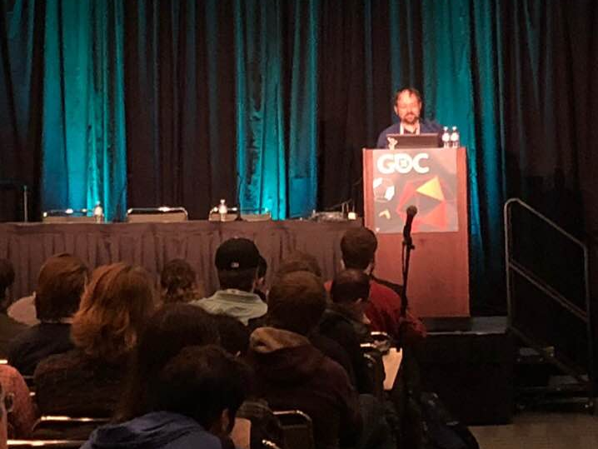
Talks by Industry Professionals
At GDC there are multiple tracks offering sessions for three days.
Notes:
Advocacy
Audio
Design
Business
Programming
Production
Vision
Visual Art
…as well as summits over two days on some topics:
Artificial Intelligence
Education

Slide 7
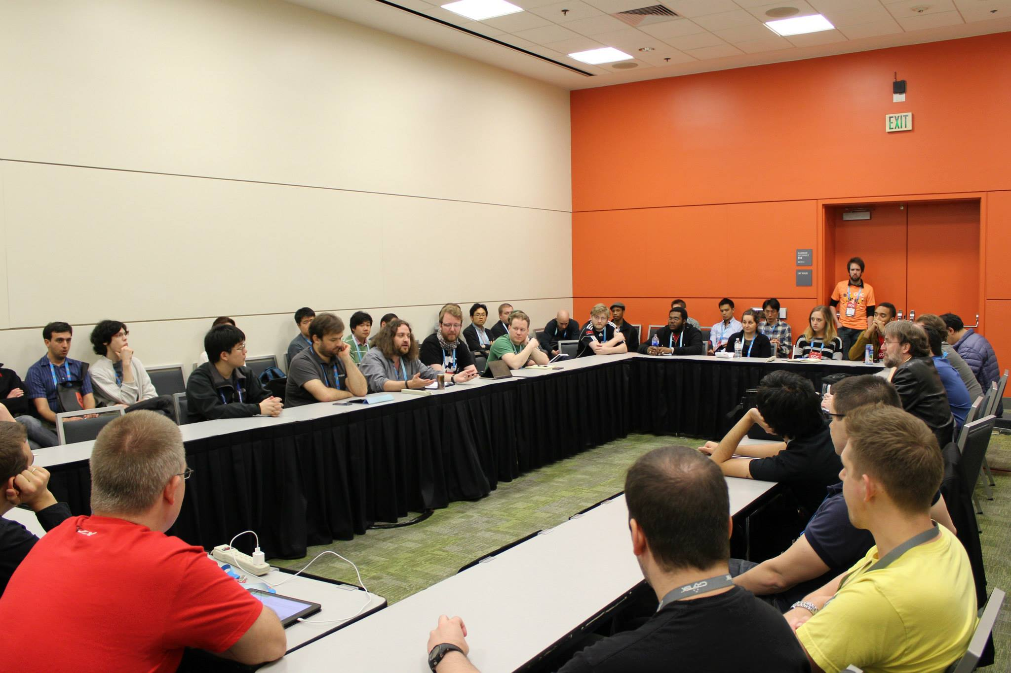
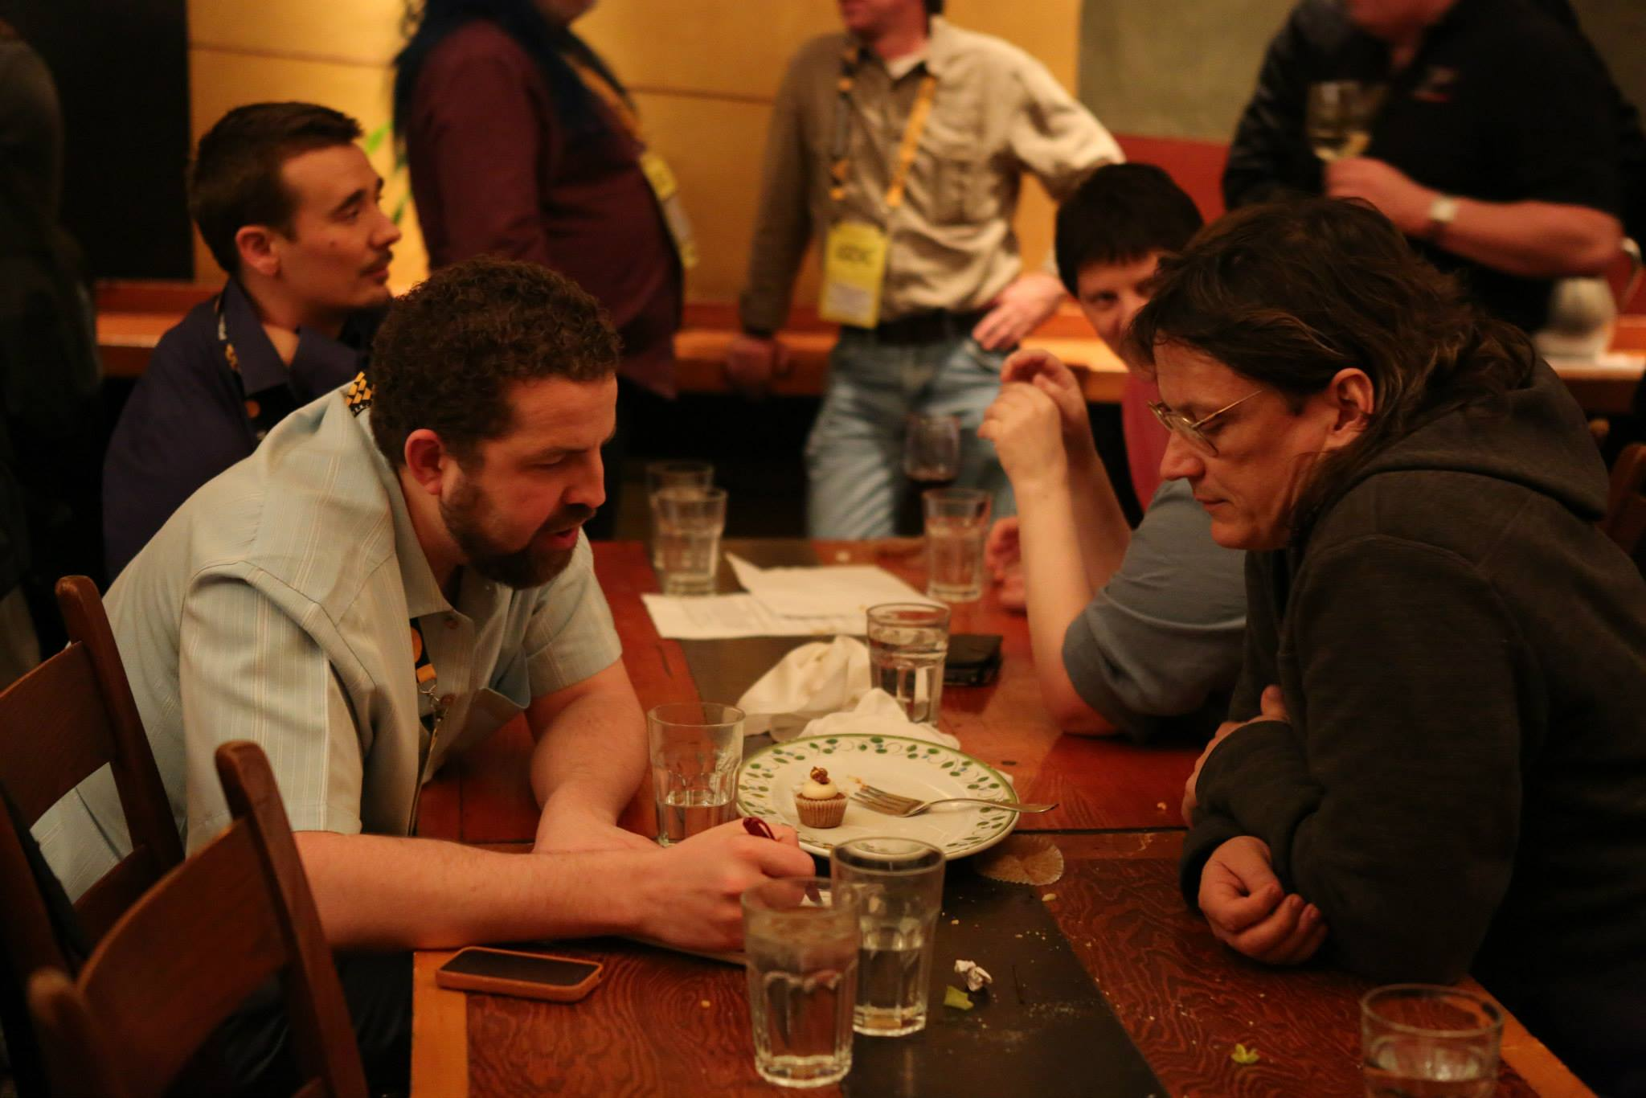
Networking (The people Kind)
It’s the one time a year game devs can expect to see most people in their specialties!

Slide 8
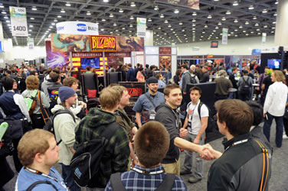
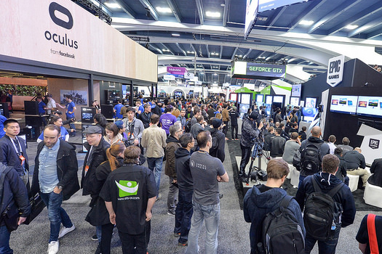
Getting a Job (or Hiring)
There is also a career pavilion for hiring and job seeking!
Notes:
Game companies, hardware companies, platforms, middleware…

Slide 9
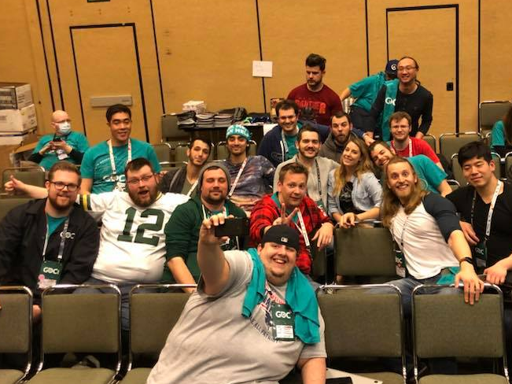
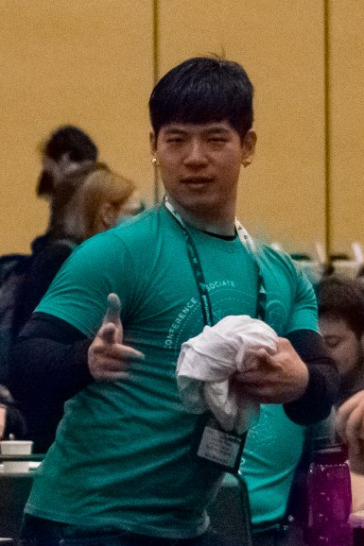
Great! How can I go?!
Well GDC is really expensive… ☹
But for conference associates, it is free. ☺

Slide 10
Thanks! Q&A

